Slide 1
Chapter objectives
Manoeuvrability and communication requirements for safe operation when manned and unmanned vessels meet

Slide 2
Thesis goals
Make a combinition between the domains of “Human computer interaction” en “Ship design”
Research a less explored challenge within the development of autonomous vessels
Ensure that results can be used by industry projects. By doing relevant research which is also communicated efficiently
Work together with different parties to combine their knowledge

Slide 3
General challenges
Problem with communication between manned and unmanned vessels
Two solutions
Maritime Technology: Avoid communication by keeping a distance
Computer science: Ensure that unmanned ships are able to communicate

Slide 4
Content
Part I: Problem of communication for unmanned vessels
Ch 1: Steps towards safe unmanned shipping
Ch 2: Decision model for safe operation
Part II
Ch 3: Decision-making process
Ch 4: Identification of situation and scenarios
Ch 5: Definition of criteria for evaluation of situation
Ch 6: Manoeuvres for validation and testing
Ch 7: Evaluation of critical evasive manoeuvre
Ch 8: Conclusion
Part III: Necessity of a protocol to enable teamwork between manned and unmanned ships
Ch 9: Foundation
Ch 10: System design and specification
Ch 11: Design evaluation
Ch 12: Conclusion
Part IV: Wrap-up
Ch 13: Final conclusion
Ch 14: Recommendations for future research
Part V
Appendix A: Current systems for safe navigation
Appendix B: Simulation environment
Appendix C: Accidents
Appendix D: Extra figures

Slide 5
Part I
The problem of communication for unmanned vessels
Describe why communication is a challenge and where a solution can be found

Slide 6
Chapter 2: Steps towards safe unmanned shipping
The objective

Slide 7
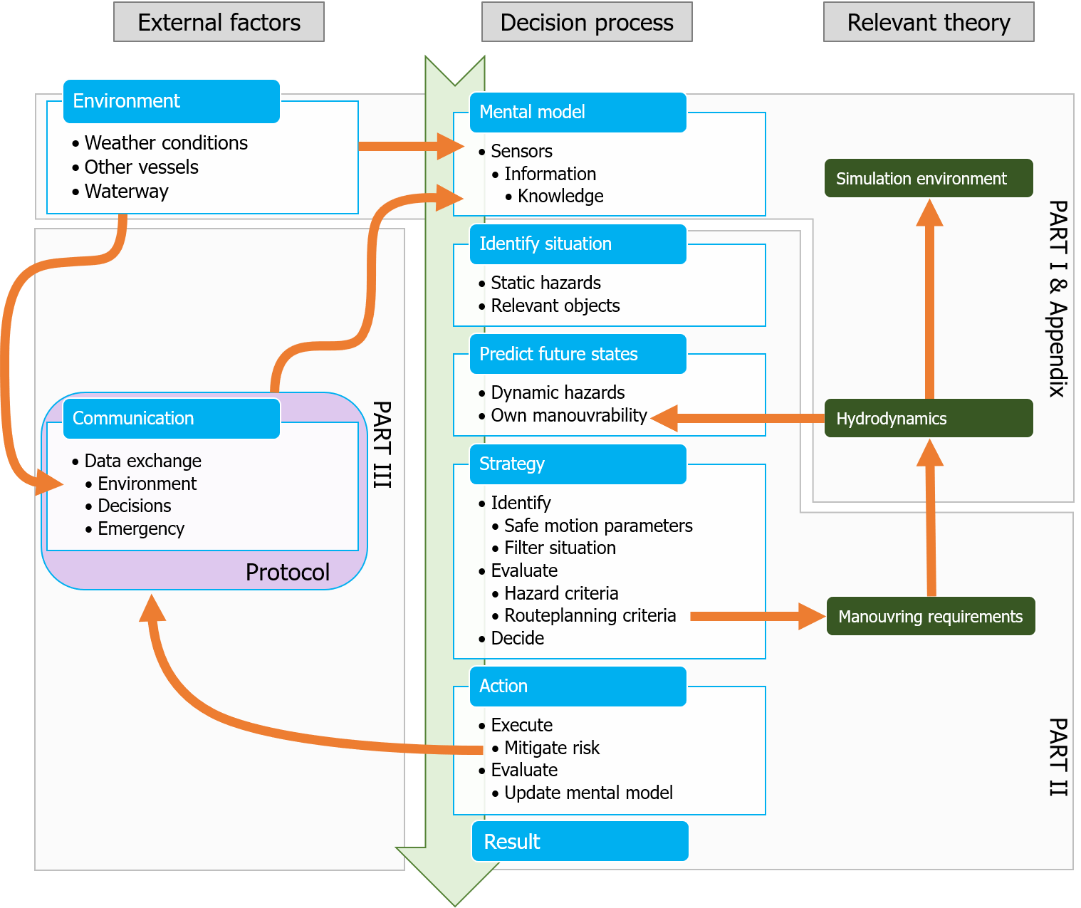

Slide 9
Part II - MT
Impact of manoeuvrability on decision making
Develop a method to test if it is possible for ships to avoid communication by statying well clear.

Slide 10
Afstand houden (MT)
How do ship manoeuvrability characteristics influence the domain for decision making, to ensure that the chosen strategy will result in an approach distance which does not require communication?
Ontwikkel methode waarmee deze vraag kan worden beantwoord

Slide 11
Proces (MT)
Inzicht krijgen in beslis proces voor mogelijke situaties
Criteria voor evalueren van situaties
Selecteren van kritieke manoeuvres
Testen van manoeuvres en tool
Evalueren van resultaten

Slide 12
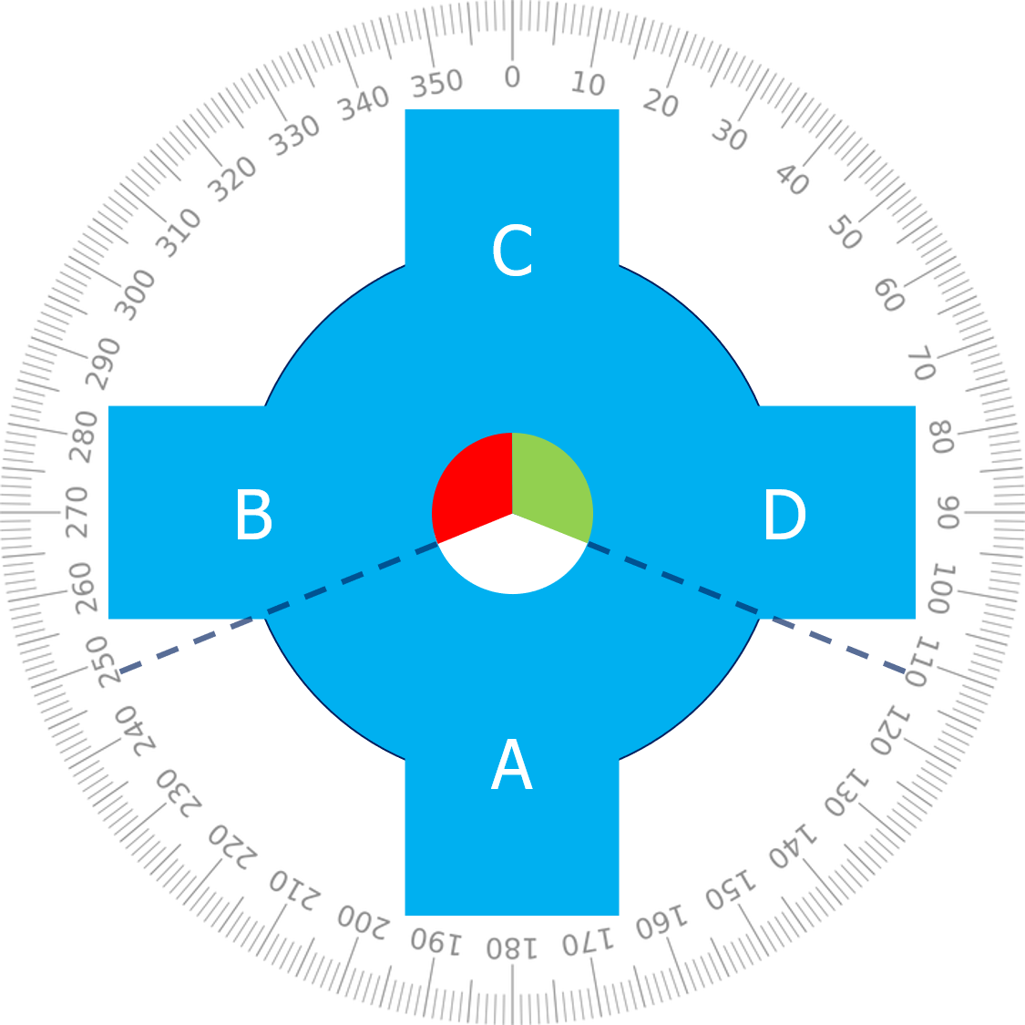
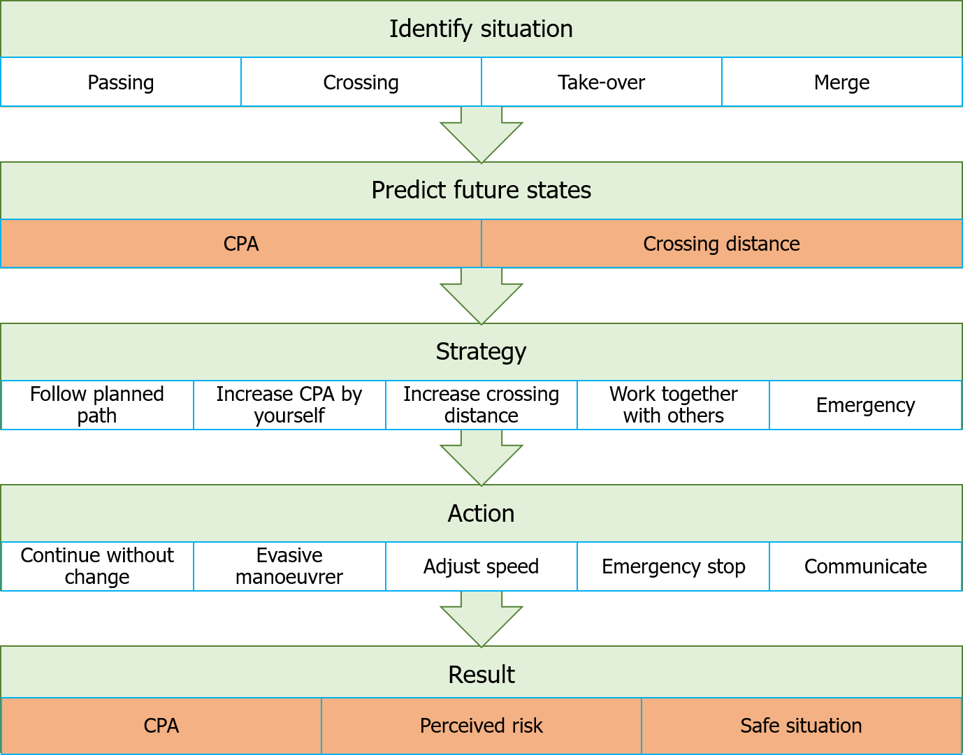
Inzicht krijgen in beslis proces voor mogelijke situaties

Slide 13
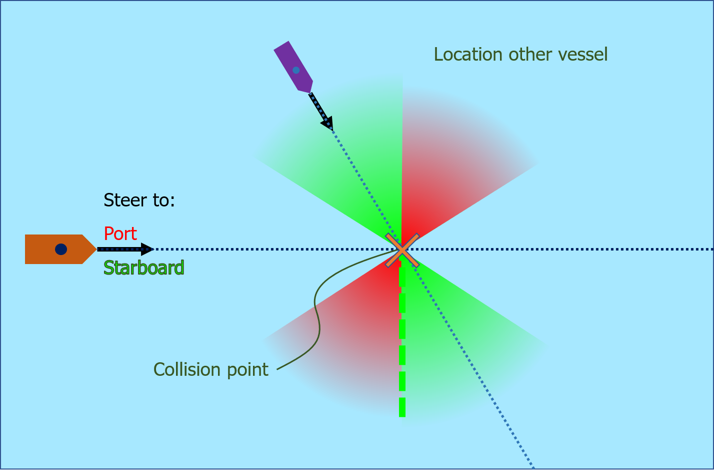
Selecteren van kritieke manoeuvres

Slide 14
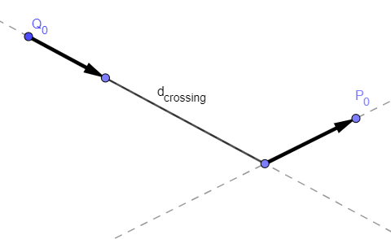
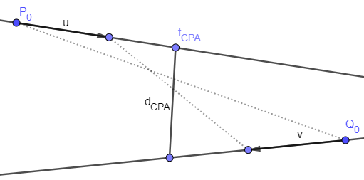
Criteria voor evalueren van situaties
Closest point of approach (CPA)
Passing distance

Slide 15
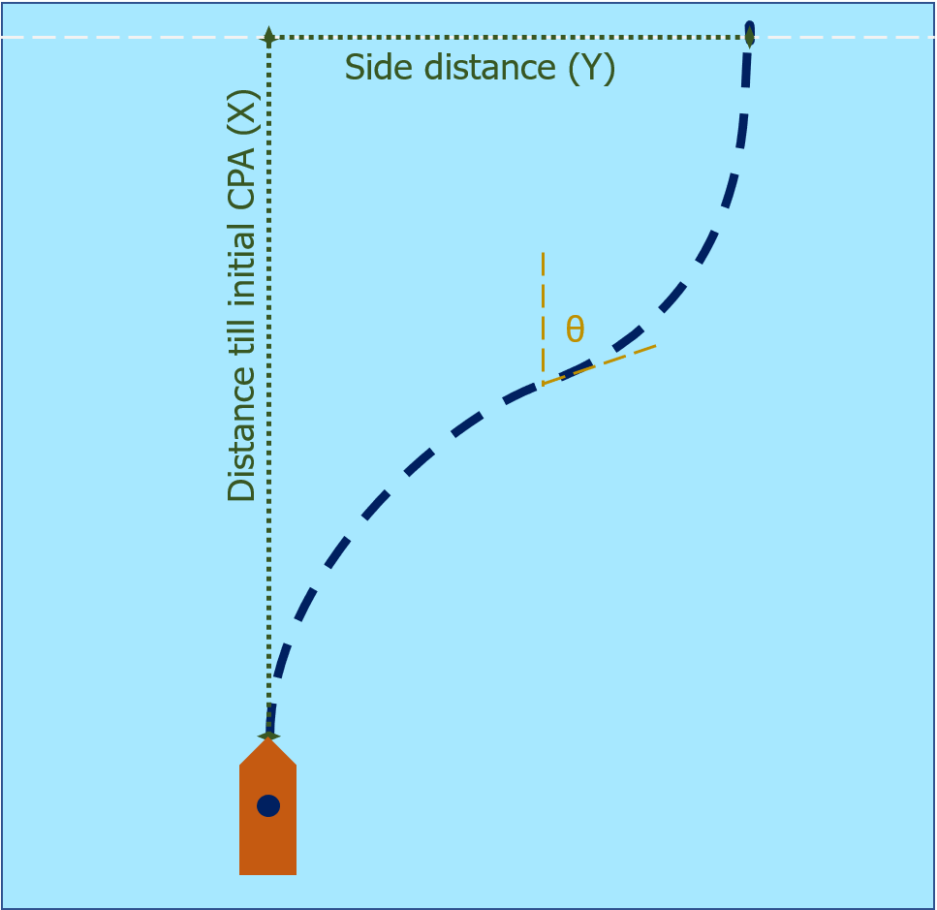
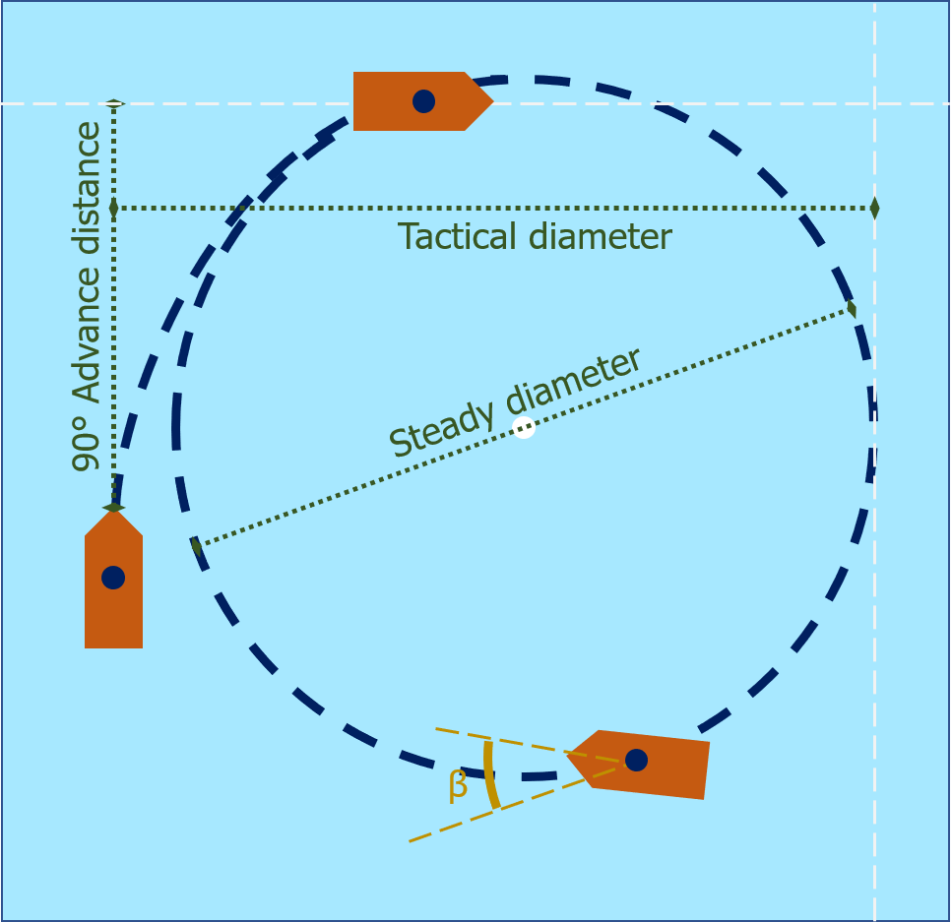
Evasive manoeuvre

Slide 16
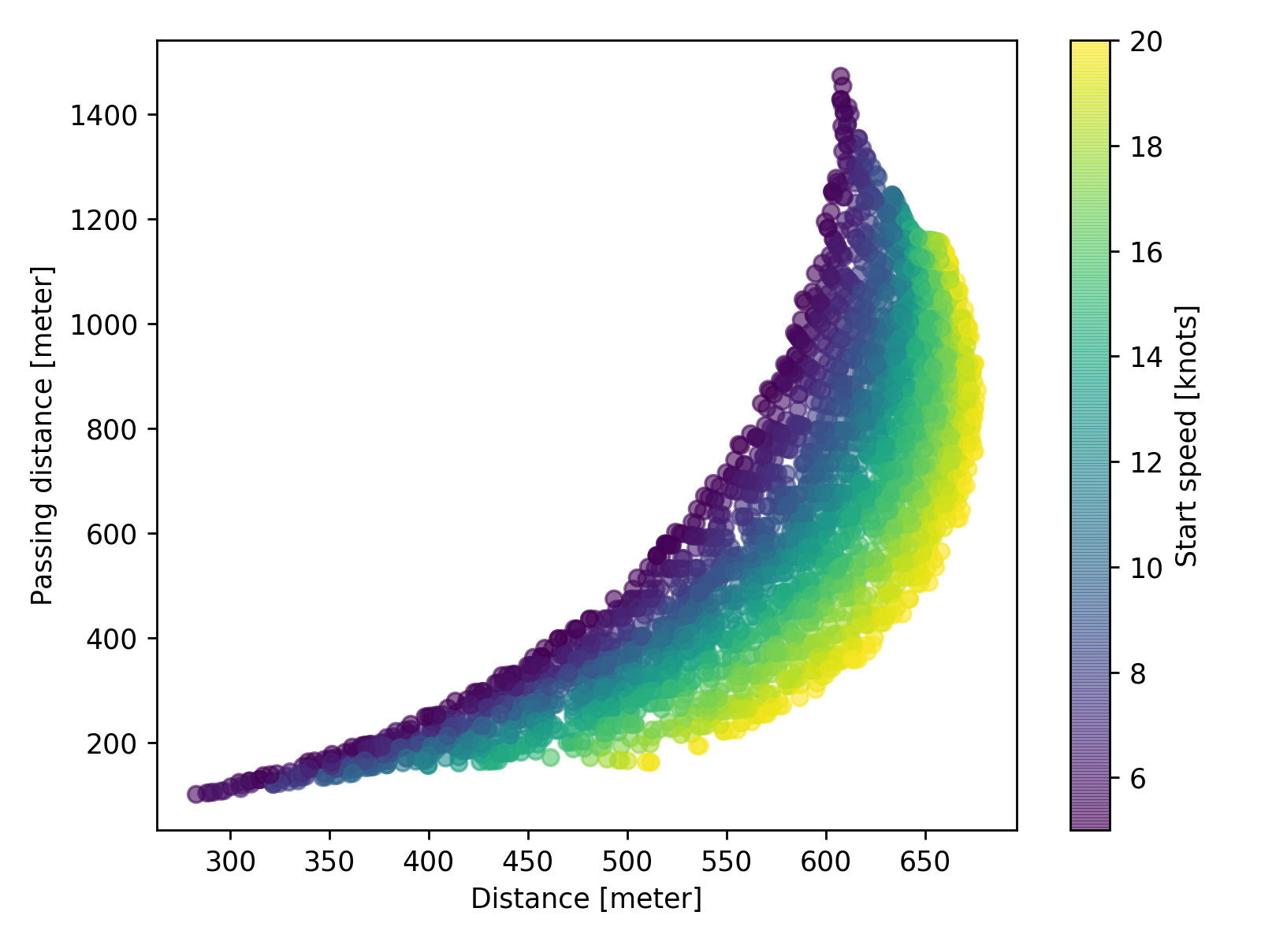
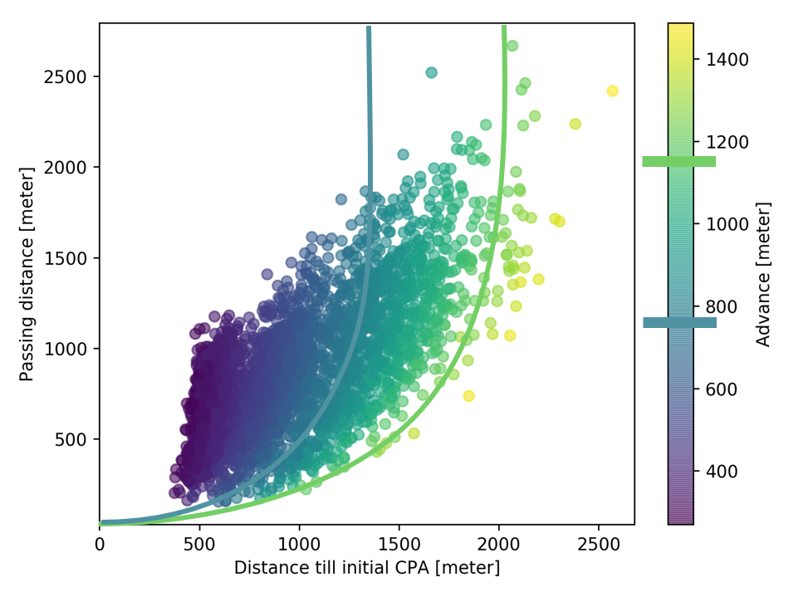
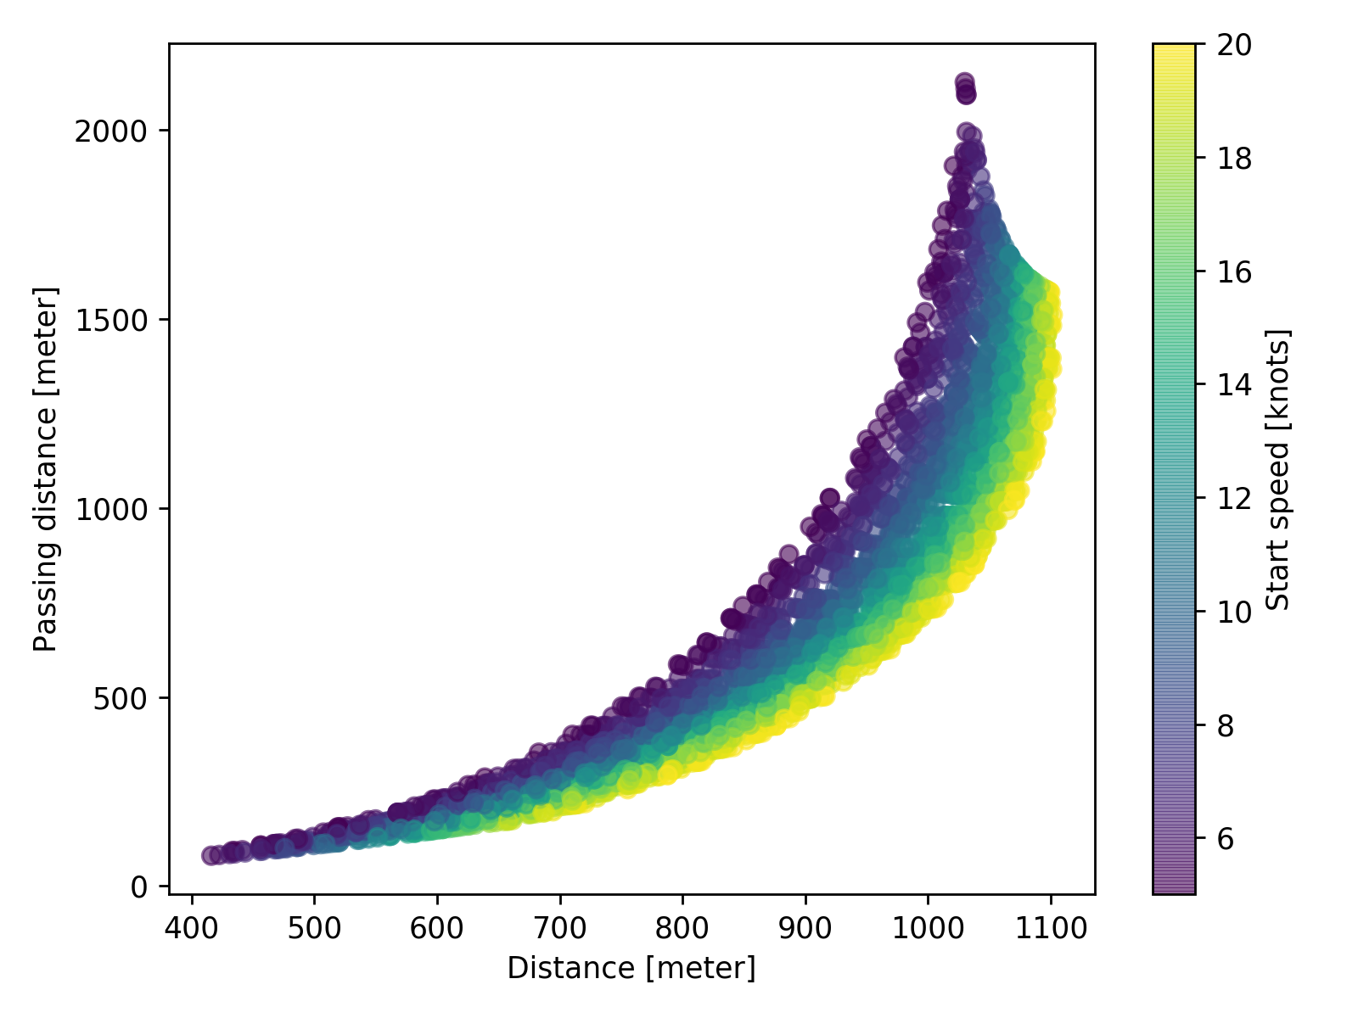
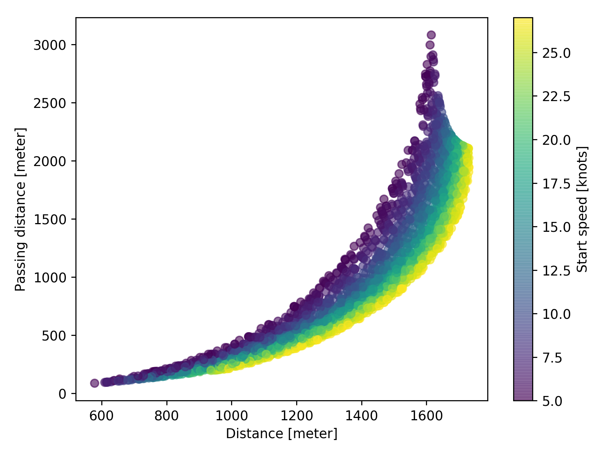
Passing distance

Slide 17
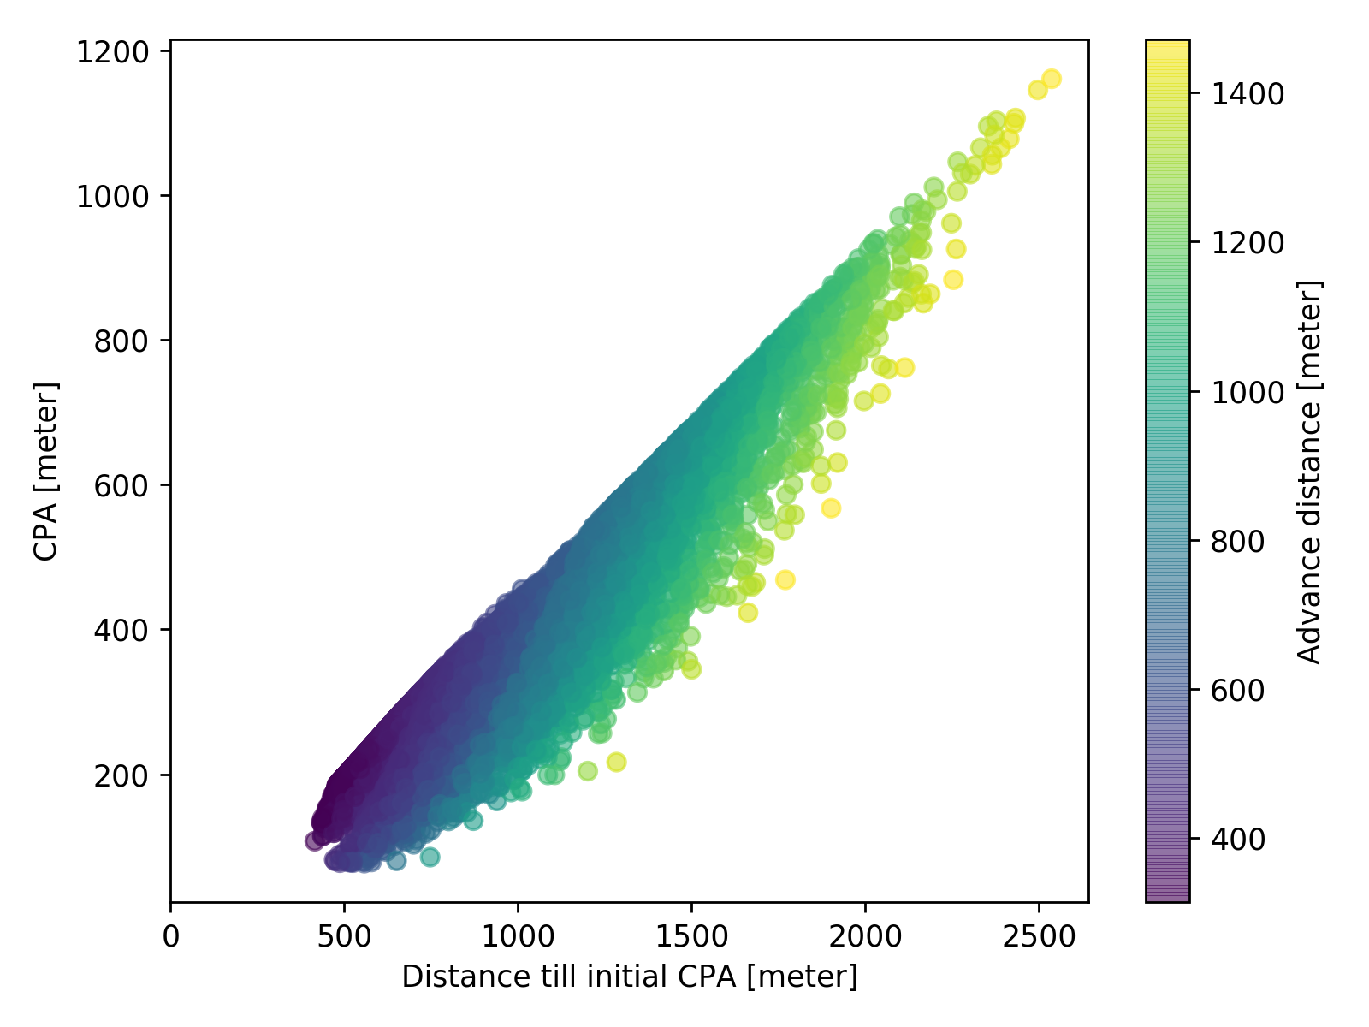
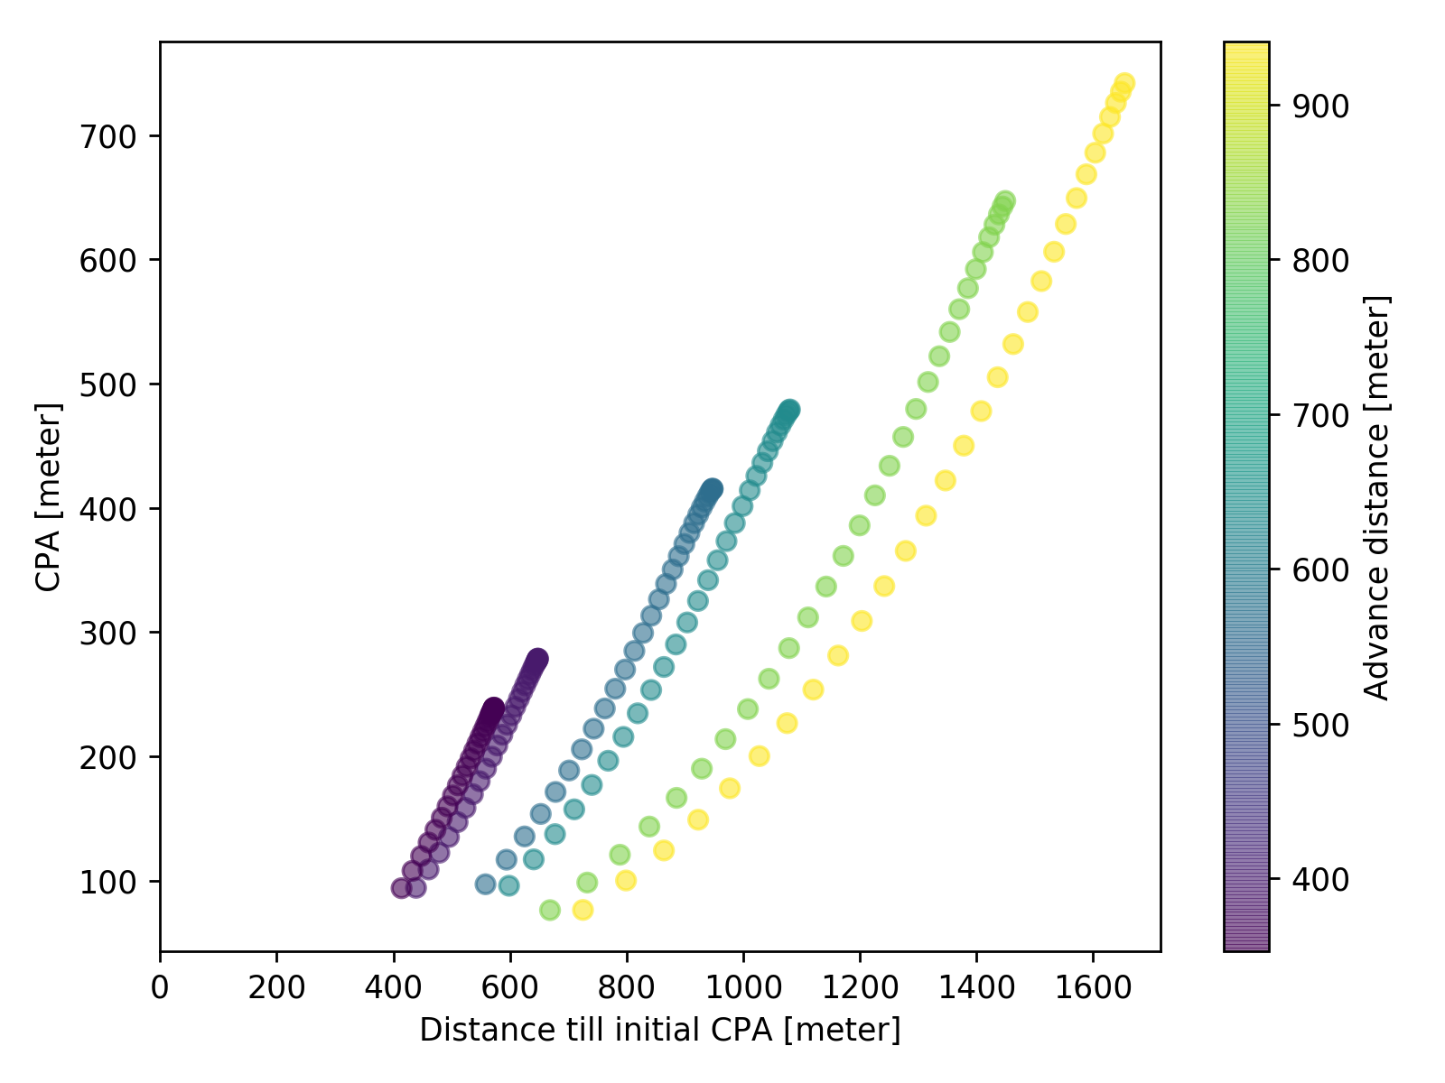
Closest point of approach

Slide 18
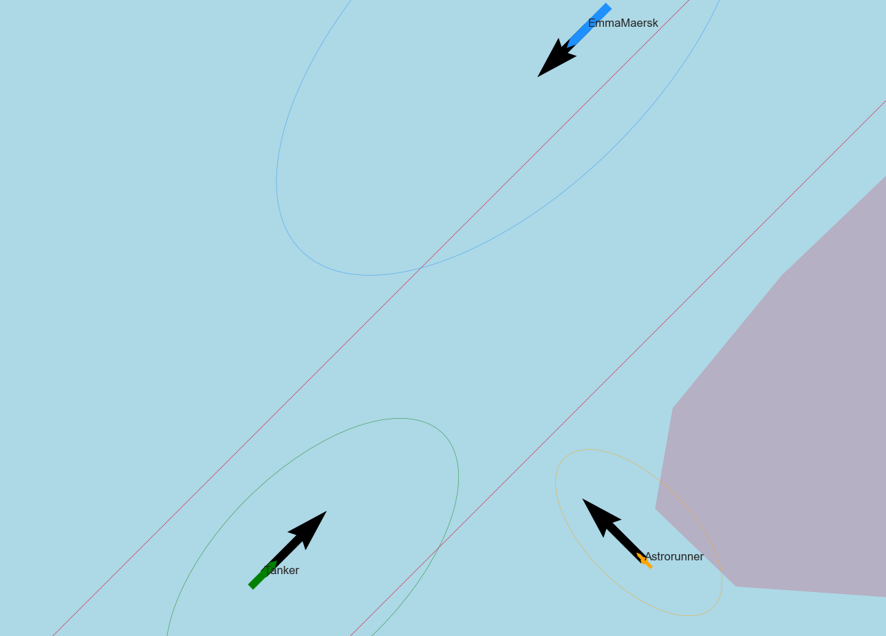
Use case example

Slide 19
Use case example
1060m

Slide 20
Antwoord op hoofdvraag
How do ship manoeuvrability characteristics influence the domain for decision making, to ensure that the chosen strategy will result in an approach distance which does not require communication?
Methode gemaakt waarmee manoeuvre kan worden getest. Laat relatie zien tussen manoeuvreer eigenschappen en safety domain
Neemt ook mee wat effect is van verbetering manoeuvreer eigenschappen
Te gebruiken voor scheepsontwerp, traffic scheme ontwerp en scheepsafhankelijke limieten
Algemeen advies kan alleen door meer situaties en manoeuvres te testen, met dezelfde methode.

Slide 21
Part III - CS
Necessity of a protocol to enable teamwork between manned and
unmanned ships

Slide 22
Communiceren (CS)
Will a protocol based on existing maritime systems and communication protocols be sufficient to ensure safe navigation, while manned and unmanned vessels encounter each other?
Gebruike situated cognitive engineering method

Slide 23
Proces (CS)
Beschrijven van probleem, hoe mensen hierin handelen en welke technologie hier aan kan bijdragen
Ontwerp maken voor oplossing
Evalueren van oplossing met behulp van gebruikers

Slide 24
Foundation
Probleem is dat huidige systemen niet zijn gemaakt om te automatiseren
Relevante stakeholders zijn:
Bemande schepen, onbemande schepen, omliggende schepen
Doel is zorgen voor betrouwbare uitwisseling van informatie
Information overload, situation awareness, vertrouwen

Slide 25
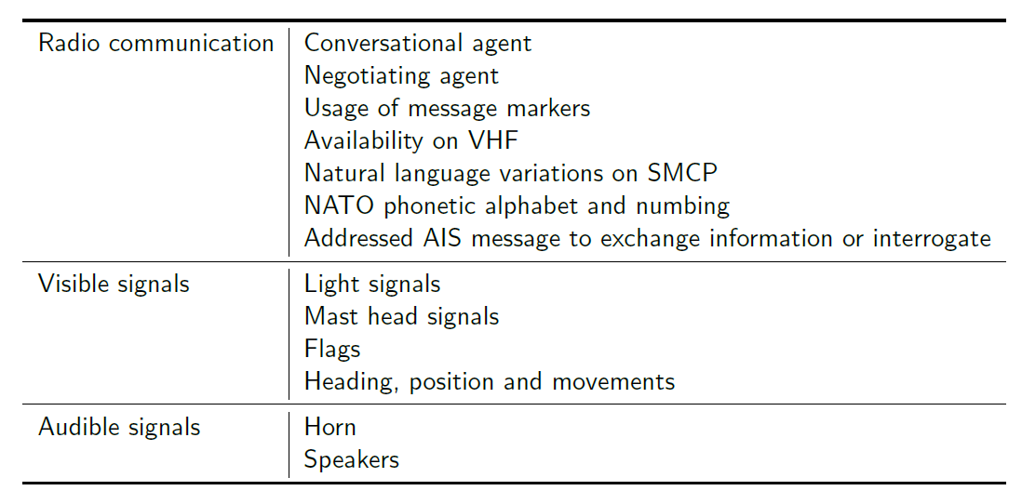
Design specification

Slide 26
Ontology
Status
Listening
Waiting
Negotiating
Messaging
Updating
Unaviable
Types of messages
Call
Acknowledge
Message
Response
Close
Speech acts
Advice
Information
Warning
Intention
Question
Instruction
Request

Slide 27
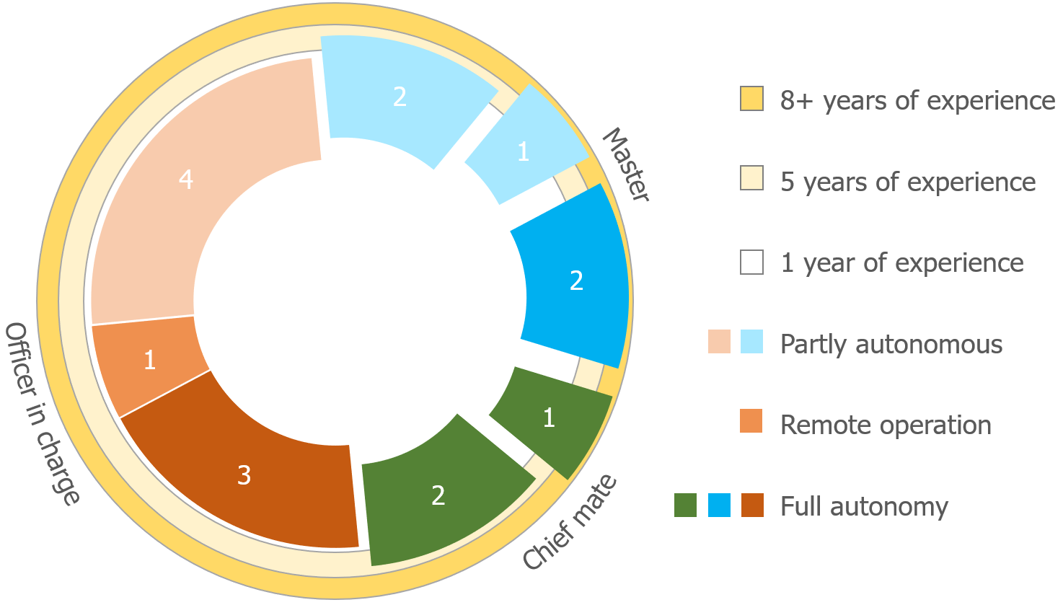
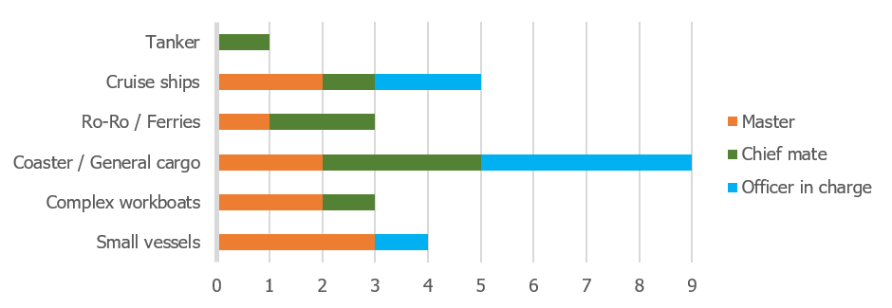
Evaluatie
Interviews met stuurmannen en kapiteins
Verschillende achtergronden
2 situaties simuleren
Met en zonder gebruik van protocol

Slide 28
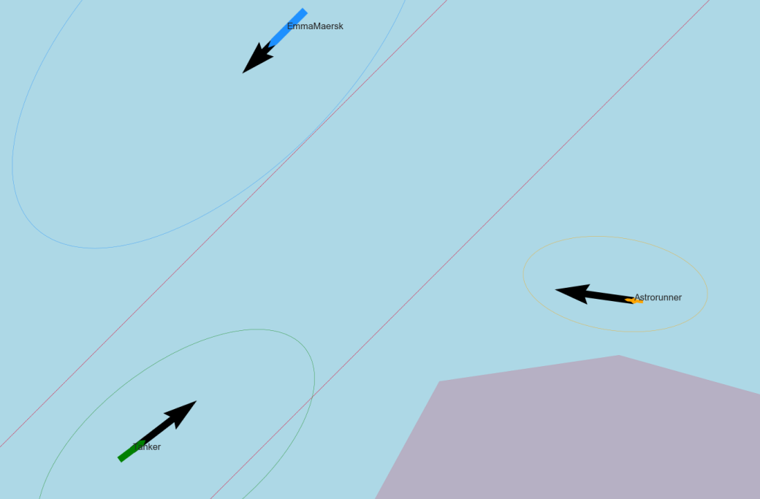
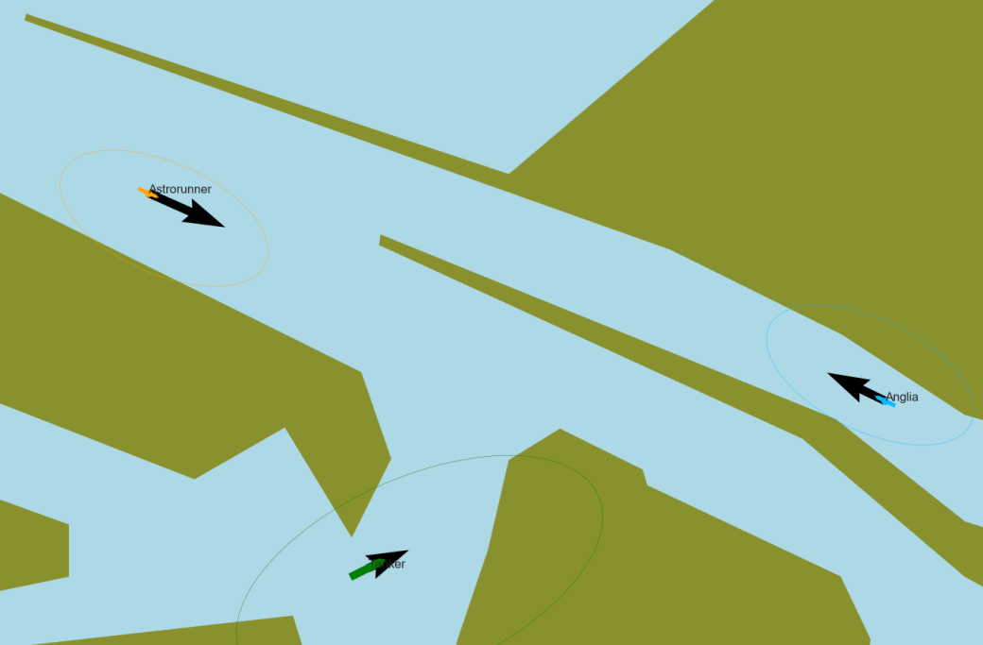
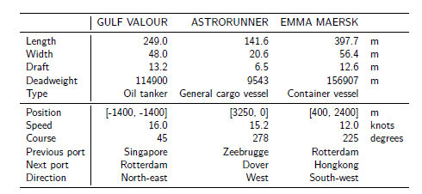
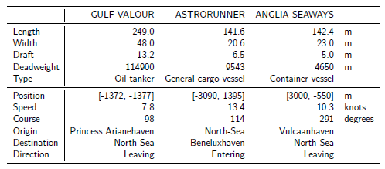
Situaties
Noordzee
Maasgeul

Slide 29
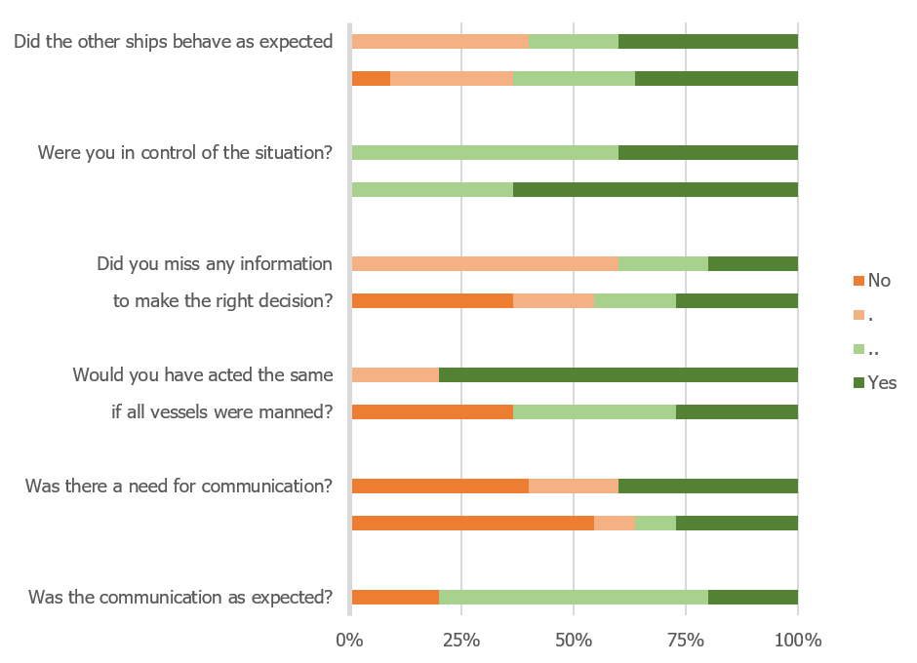
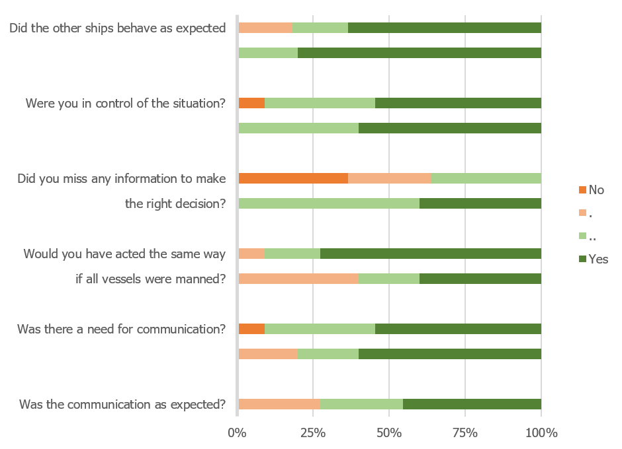
Evaluatie situaties
Noordzee
Maasgeul
Protocol vs no-communication

Slide 30
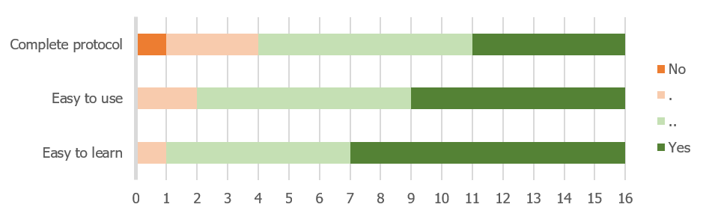
Feedback op protocol
Start of every message has the purpose to get attention, by calling specific vessel: <name other vessel>, <name other vessel>. This is <name own vessel>.
Common practice is to use the words as defined by SMCP (alter course, instead of change course). The sentences are often not used as described by SMCP.
Marker words are not used.
When responding, the previous message is repeated.
Message is ended with over, conversation with over and out.
Problem with non-western accents(?)

Slide 31
Conclusies experiment
Performance
With protocol they were able to make decision earlier, resulting in more control
They used words from SMCP, not exact sentences, did not use markerwords
Trust
Worried about voice recognition for non-western accents
Protocol works well over radio
Situation awareness
Protocol has small effect on free cognitive space
Satisfaction
SMCP is idiot proof, not much changes are needed to current way of working, therefore they liked the design

Slide 32
Antwoord op hoofdvraag
Will a protocol based on existing maritime systems and communication protocols be sufficient to ensure safe navigation, while manned and unmanned vessels encounter each other?
SMCP as core of protocol
Make natural language variations, as SMCP is too complete
Situated cognitive engineering method works well to make design
There is already a trend towards maritime english for safety

Slide 33
Part IV
Wrap-up

Slide 34
Doelen behaald?
Combinatie gemaakt tussen domeinen van “Human computer interaction” en “Ship design”.
Laten zien dat er binnen lopende projecten naar communicatie moet worden gekeken, en daar ook een wetenschappelijke methode bij voorgesteld.
Contact gehad met heel veel partijen waardoor onderzoek rekening houdt met praktische toepassing (loodswezen, STC, Damen, Marin, RH Marine, kapiteins)

Slide 35
Plannen
Aanvragen examens (CS & MT)
Concept 4 (?)
Inleveren definitief rapport
W.V.T.T.K.?

Slide 36
Groenlicht Ingmar
Manoeuvrability and communication requirements for safe operation when manned and unmanned vessels meet
?

